Slide 1


Android Lecture #5
Activity, Intent,
Manifest,Life Cycle

Slide 2


Index
Activity
Intent
Manifest
Activity Life Cycle

Slide 3

1. Activity
Application
Provide AndroidManifest.xml
Activity
A mobile screen
Service
Running in the background process
Broadcast
Receiver
Method of sending message to some objects
Content
Provider
Manage access to a structured set of data

Slide 4
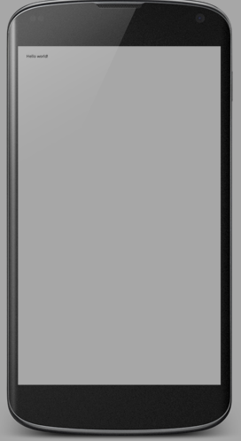
2. Intent
Intent
Activity 1
Intent
Activity 2

Slide 5
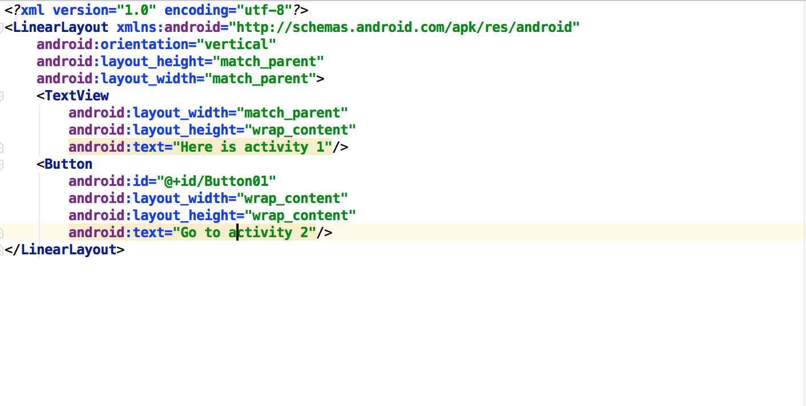
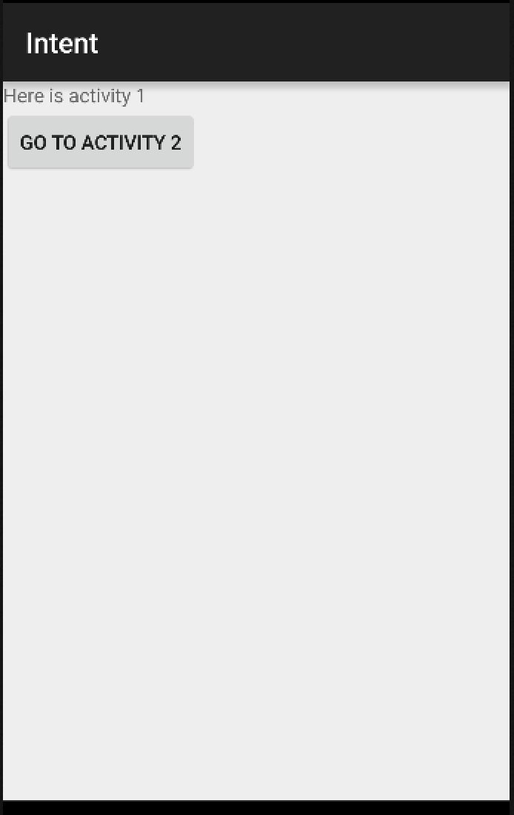
2. Intent
Intent source (activity_main.xml)

Slide 6
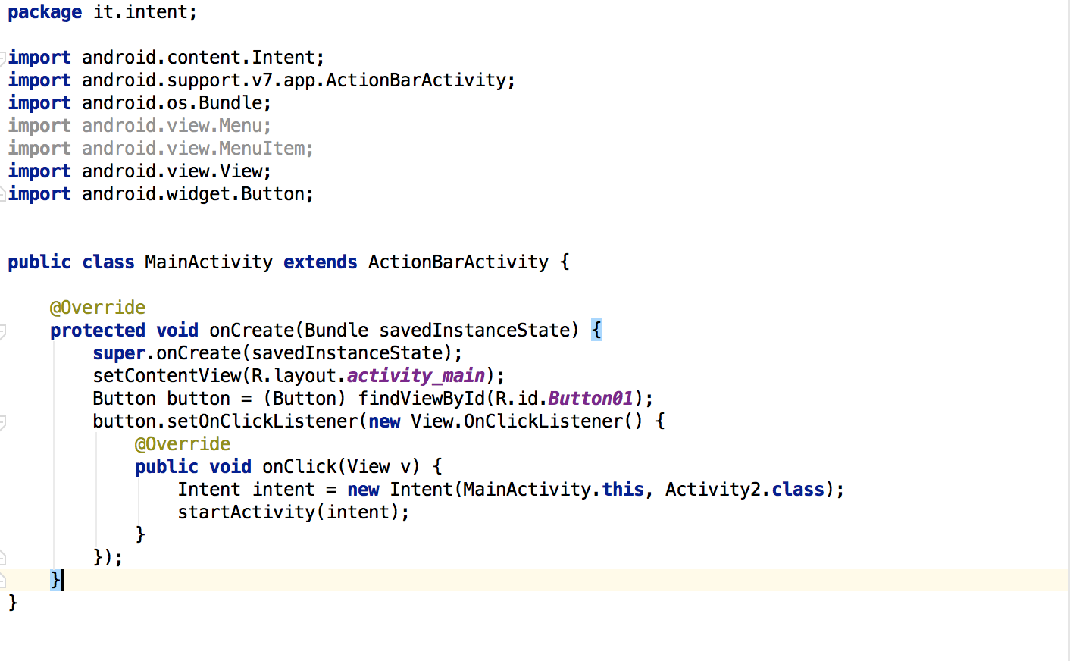
2. Intent
Intent source (MainActivity.java)

Slide 7
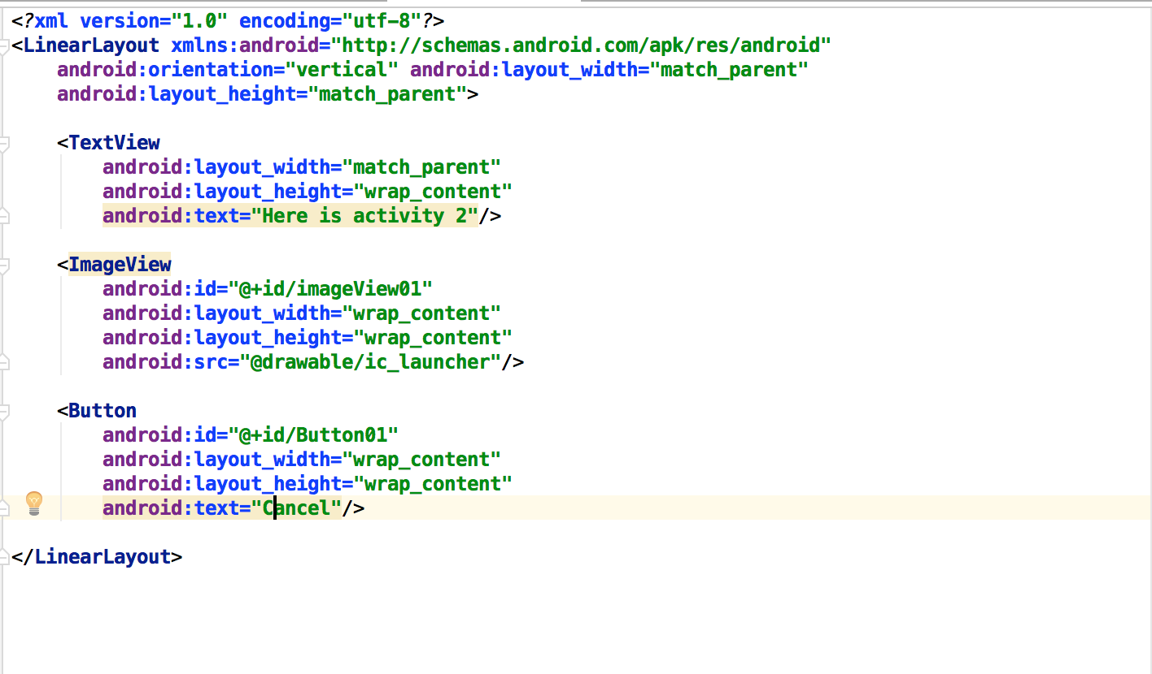
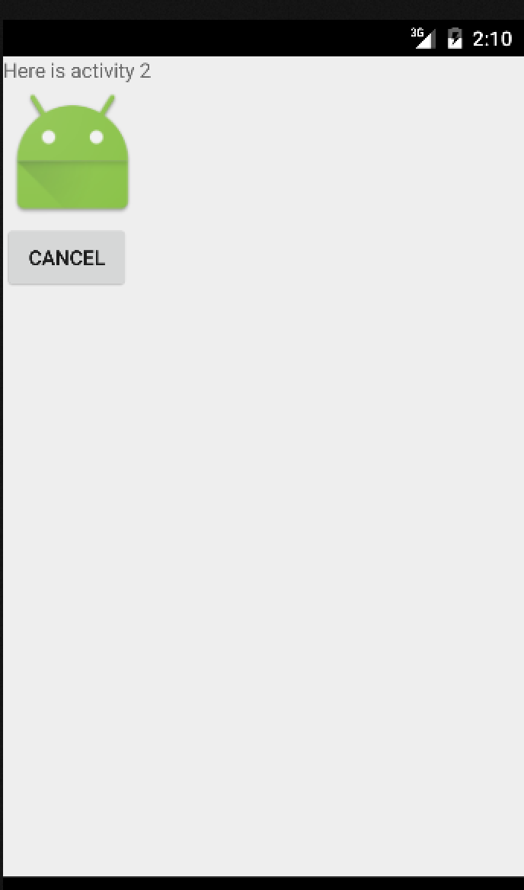
2. Intent
Intent source (activity2.xml)

Slide 8
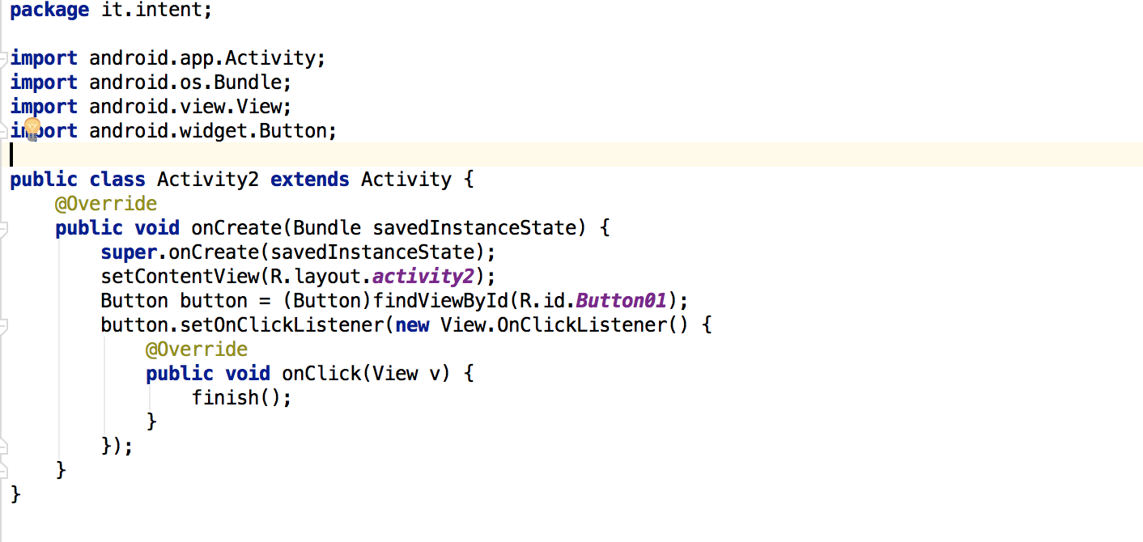
2. Intent
Intent source (activity2.java)

Slide 9
3. Manifest
Manifest
A list of application information
Describe component of the application
Declare permission of the application

Slide 10
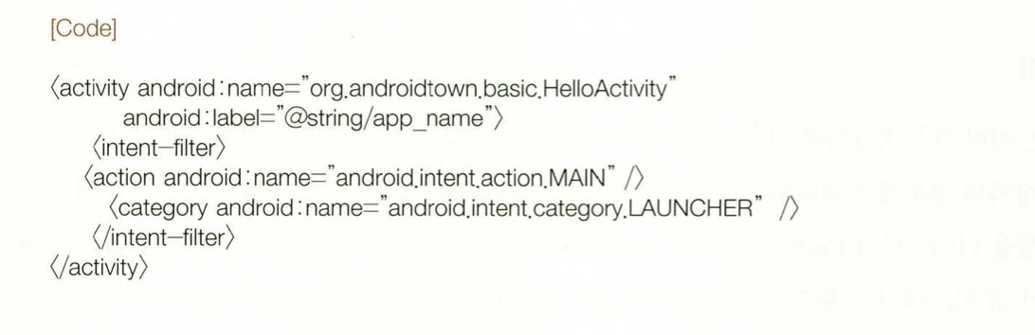
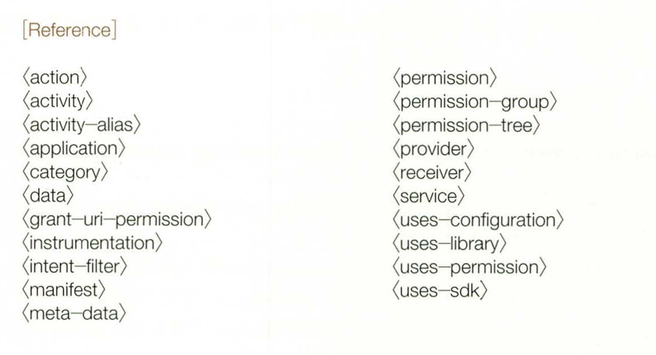
3. Manifest
Manifest structure

Slide 11
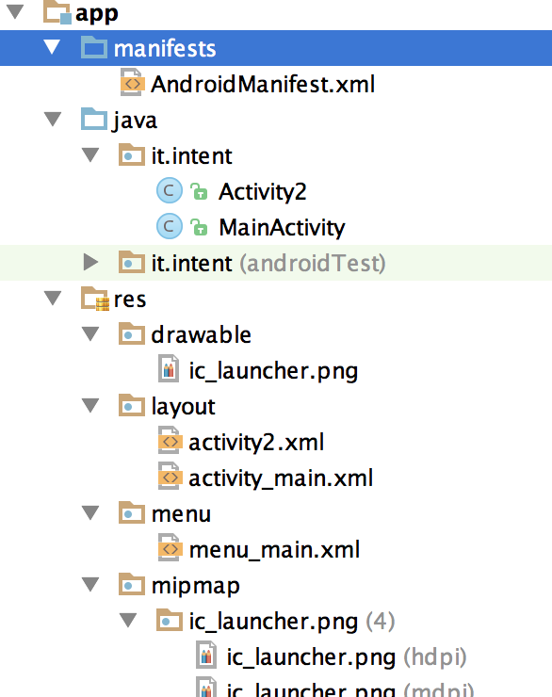
3. Manifest
Location of manifest file
Add activity to AndroidManifest.xml

Slide 12
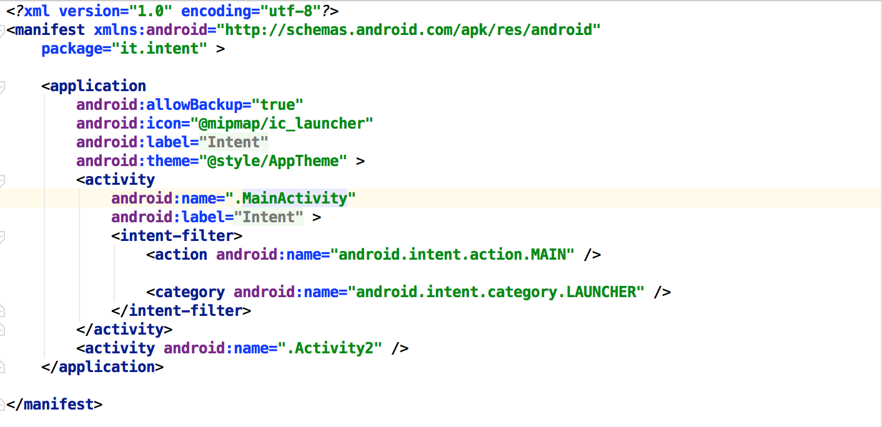
3. Manifest
AndroidManifest.xml
Your package
Your activity
Add activity

Slide 13
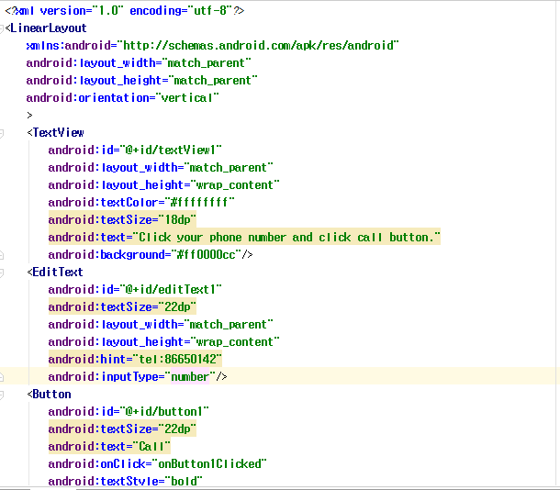
Intent Example

Slide 14

Intent Example

Slide 15
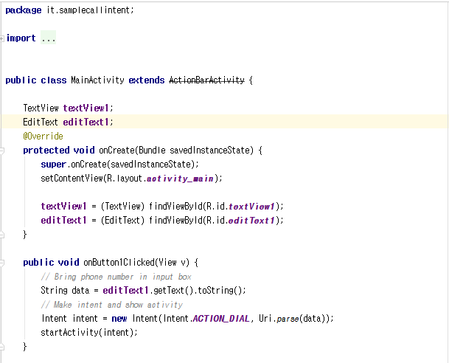
Intent Example

Slide 16
4. Activity Life Cycle
Activity State
Running
Current mobile screen
Interact user and mobile
Paused
Can no Interact user and mobile
Can exit since lack of memory
Stopped
Invisible mobile screen
Can exit since lack of memory

Slide 17
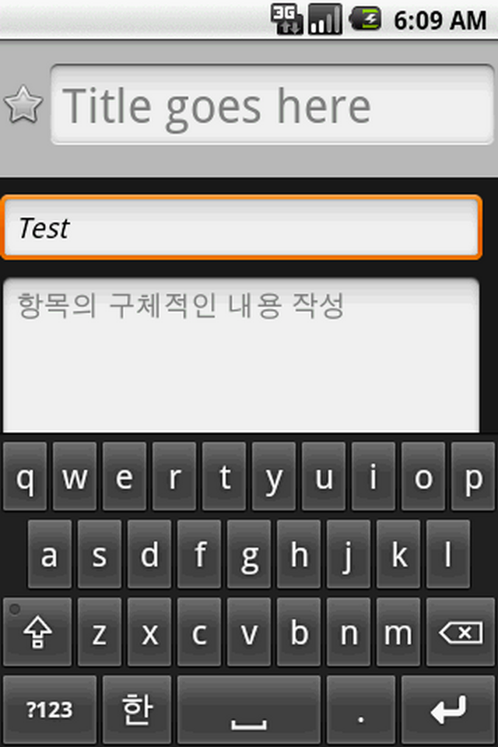
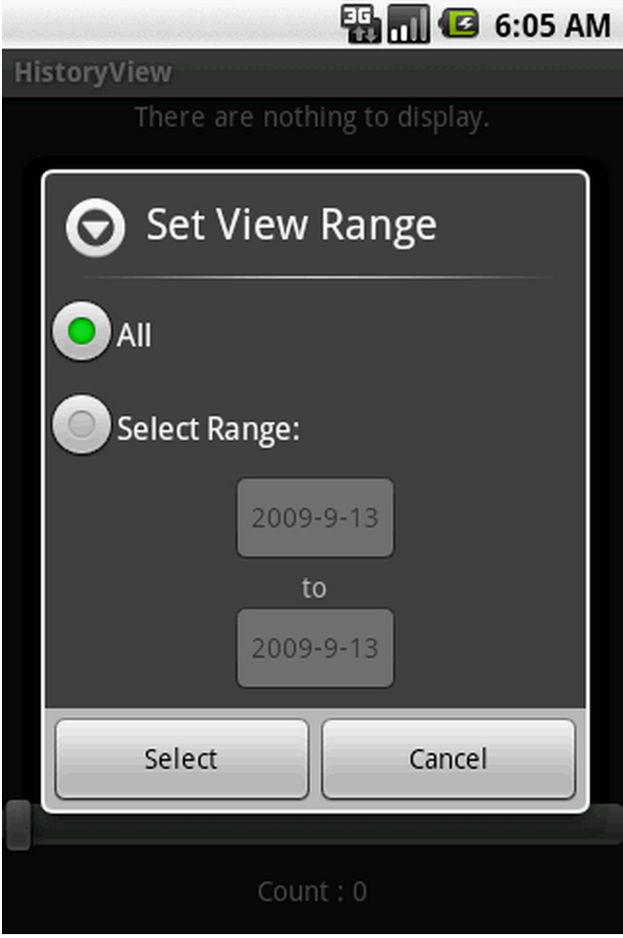
4. Activity Life Cycle
Running
Paused

Slide 18
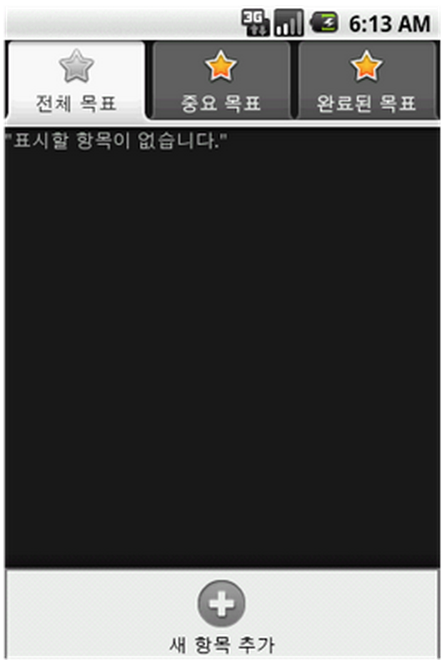
4. Activity Life Cycle
Stopped

Slide 19
4. Activity Life Cycle
Activity Life Cycle
Activity Start
onCreate()
onStart()
onRestart()
onResume()
Process shut down
Activity come forward
Running Activity
Activity come forward
Other activity come forward
Demand memory
onPause()
Can not see actvity
onStop()
onDestroy()
End Activtiy
Notes:
직접 보여주기

Slide 20
4. Activity Life Cycle
Activity Life Cycle Method
Method | Change of activity state
onCreate() | (Activity creation)
onStart() | (Activity creation) -> Paused
onResume() | Paused -> Activation
onPause() | Activation -> Paused
onStop() | Paused -> Stop
onRestart() | Stop -> Paused
onDestory() | Stop -> (Activity destroyed)

Slide 21
Thank you!

